Slide 1


Azure Functions
Build apps faster with serverless technologies
[Presenter name]
Microsoft

Slide 2
History of cloud development
Increasingly advanced cloud technologies have led companies to entrust more and more of their IT activities to service providers
On-premises
IaaS
PaaS
Serverless
Servers & storage
Security
OS & software
Dev tools
Apps & services
Notes:
Speaker guidance: This slide has FOUR (4) clicks of animation—one for each compute option.

Slide 3
Before cloud…
What is the right size of
servers for my business needs?
How do I deploy new code to my server?
What media should I
use to keep backup?
What happens in case of
server hardware failure?
Which packages should be on my server?
What size of servers
should I buy?
Who monitors
my App?
How often should I backup my server?
How can I scale my app?
How can I increase server utilization?
Who has physical
access to my servers?
Which OS should I use?
Do I need secondary network connection?
Are my server in a secure location?
What happens if the
power goes out?
Who monitors
my Servers?
Do I need a UPS?
What storage I need to use?
How many servers
do I need?
How can I dynamically configure my app?
It takes how long to provision a new server?
How often should
I patch my servers?

Slide 4
…then IaaS set the table stakes for digital business…
What is the right size of servers for my business needs?
How can I increase server utilization?
How many servers do I need?
How can I scale my app?
How often should I patch my servers?
How do I deploy new code to my server?
How often should I backup my server?
Which OS should I use?
Which packages should be on my server?
Who monitors my App?

Slide 5
…then PaaS, critical for digital transformation
What is the right size of “servers” for my business needs?
How can I increase “server” utilization?
How many “servers” do I need?
How can I scale my app?

Slide 6
Serverless: the platform for next gen apps, today
How do I architect my app to become Serverless?

Slide 7


What is serverless?
Full abstraction of servers
Developers can just focus on their code—there are no distractions around server management, capacity planning, or availability.
Instant, event-driven scalability
Application components react to events and triggers in near real-time with virtually unlimited scalability; compute resources are used as needed.
Pay-per-use
Only pay for what you use: billing is typically calculated on the number of function calls, code execution time, and memory used.*
*Supporting services, like storage and networking, may be charged separately.

Slide 8

What are the benefits?
Solve business problems—not technology problems related to undifferentiated heavy lifting
Focus
Shorter time to market
Fixed costs converted to variable costs
Better service stability
Better development and testing management
Less waste
Efficiency
Simplified starting experience
Easier pivoting means more flexibility
Easier experimentation
Scale at your pace—don’t bet the farm on Day 1
Natural fit for microservices
Flexibility

Slide 9
FaaS is at the center of serverless Functions-as-a-Service programming model use functions to achieve true serverless compute
Single responsibility
Functions are single-purposed, reusable pieces of code that process an input and return a result
Short lived
Functions don’t stick around when finished executing, freeing up resources for further executions
Stateless
Functions don’t hold any persistent state and don’t rely on the state of any other processes
Event driven & scalable
Functions respond to predefined events, and are instantly replicated as many times as needed

Slide 10

What is Azure Functions? An event-based, serverless compute experience that accelerates app development
Azure Functions = FaaS++
Integrated programming model
Use built-in triggers and bindings to define when a function is invoked and to what data it connects
Enhanced development experience
Code, test and debug locally using your preferred editor or the easy-to-use web based interface including monitoring
Hosting options flexibility
Choose the deployment model that better fits your business needs without compromising development experience
Notes:
Building on top of the FaaS programming model, Azure Functions keep all the mentioned features and extend your possibilities with additional capabilities that help to reduce your development time and boost productivity, while using best in class tools.

Slide 11

Focus on code, not plumbing
No infrastructure management
Auto-scale based on your workload
No wasted resources, pay only for what you use

Slide 12


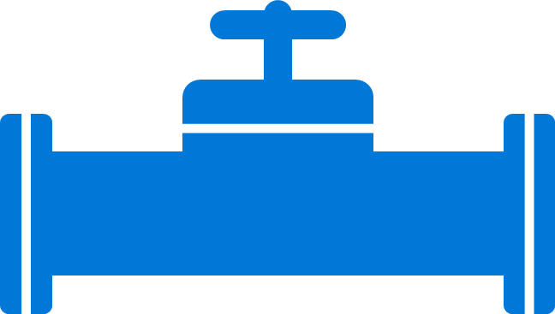
Boost development efficiency
Use triggers to define how functions are invoked
Avoid hardcoding with preconfigured JSON files
Build serverless APIs using HTTP triggers
Connect to data with input and output bindings
Bind to Azure solutions and third-party services
Use HTTP bindings in tandem with HTTP triggers
Triggers
Bindings
Define one API surface for multiple function apps
Create endpoints as reverse proxies to other APIs
Condition proxies to use variables
Debug C# and JavaScript functions locally
Use debugging tools in Azure portal, VS, and VS Code
Proxies
Local debugging
Save time with built-in DevOps
Deploy functions using App Service for CI
Leverage Microsoft, partner services for CD
Integrate with Azure Application Insights
Get near real-time details about function apps
See metrics around failures, executions, etc.
CI/CD
Monitoring
Notes:
Additional information
Triggers and bindings – https://docs.microsoft.com/en-us/azure/azure-functions/functions-triggers-bindings
Monitoring—https://azure.microsoft.com/en-us/services/application-insights/
Local debugging—https://docs.microsoft.com/en-us/azure/azure-functions/functions-run-local#run-functions-locally
CI/CD—https://docs.microsoft.com/en-us/azure/azure-functions/functions-continuous-deployment
Run locally—https://docs.microsoft.com/en-us/azure/azure-functions/functions-run-local
Proxies—https://docs.microsoft.com/en-us/azure/azure-functions/functions-proxies

Slide 13

Boost development efficiency
Trigger object
Your code
Input object
Input Binding
Output object
Trigger
Output Binding
Notes:
There is a lot of code you can save thanks to the Functions programming model based on triggers and bindings, as this code to connect to different services (either for trigger data and input/output operations) is done by the platform, improving your development time as you don’t lose a minute on connections code that tend to be reused a lot of times.
See the full list of services with Triggers and bindings – https://docs.microsoft.com/en-us/azure/azure-functions/functions-triggers-bindings

Slide 14


Gain flexibility and develop your way
Write code in C#, JavaScript, F#, and Java
Continuous investment in new, experimental languages
Write stateful functions in a serverless environment
Simplify complex, stateful coordination problems
Add the extension to enable advanced scenarios
Multiple languages
Durable Functions
Choose from six consumption plans to run Functions
Run your first million function executions for free
Simplify coding for new users with native Azure portal
Select from popular editors, like VS, VS Code, CLI, Maven*
Hosting options
Dev options
*VS and VS Code only support C#; Maven only supports Java
Notes:
Additional information
Languages—https://docs.microsoft.com/en-us/azure/azure-functions/supported-languages
Dev options—
Azure Functions portal—https://docs.microsoft.com/en-us/azure/azure-functions/functions-create-first-azure-function
Visual Studio—https://docs.microsoft.com/en-us/azure/azure-functions/functions-develop-vs
Visual Studio Code—https://code.visualstudio.com/docs
CLI—https://docs.microsoft.com/en-us/azure/azure-functions/functions-create-first-azure-function-azure-cli
Java/Maven—https://docs.microsoft.com/en-us/azure/azure-functions/functions-create-first-java-maven
Hosting options—https://azure.microsoft.com/en-us/pricing/details/functions/
Durable Functions—https://docs.microsoft.com/en-us/azure/azure-functions/durable-functions-overview

Slide 15





Gain flexibility and develop your way
Consumption
AS Plan
AS Environment
Azure Stack
Runtime
IoT Edge*
Serverless
Free, Basic, Standard, Premium
Network isolation
On-premises
Functions on your server
On devices
Only pay for what you use; charges apply per execution and per GB second
Gain all the advantages of Functions along with Microsoft’s financially-backed SLA and the always-on features of an App Service Plan
Use a dedicated App Service cloud environment (ASE) that comes with network isolation for apps, greater scale, and secure connectivity to local vNets
Bring the power of the entire Azure stack to your own data centers
Run Functions on your local server; does not include the entire Azure stack
Deploy custom Azure modules on IoT devices
Hosting options
*Currently in preview

Slide 16

Sample scenarios for Functions
Web application backends
Mobile application backends
IoT-connected backends
Conversational bot processing
Real-time file processing
Real-time stream processing
Automation of scheduled tasks
Extending SaaS Applications

Slide 17



Web application backends
Scenario Example
Retail
Online orders are picked up from a queue, processed and the resulting data is stored in a database.
Request made in a web app
Request queued in Service Bus
A function processes the request…
…sends output to Cosmos DB

Slide 18


Mobile application backends
Scenario Example
Financial Services
Colleagues use mobile banking to reimburse each other for lunch: the person who paid for lunch requests payment through his mobile app, triggering a notification on his colleagues’ phones.
HTTP API call from a mobile app
Call processed by a function
Output data stored in Cosmos DB
Data transfer triggers second function…
…which sends notifications using Notifications Hub

Slide 19


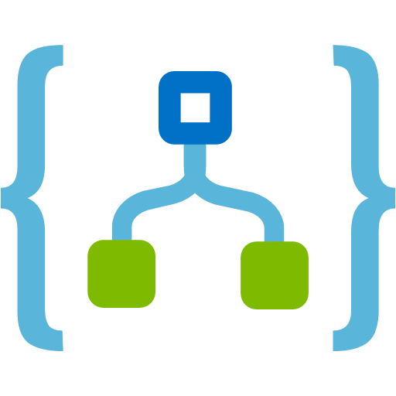


IoT-connected backends
Connected IoT devices producing data
Scenario Example
Manufacturing
Data sent to IoT Hub
A manufacturing company uses IoT to monitor its machines. Functions detects anomalous data and triggers a message to Service department when repair is required.
Data with special condition routed to a function
A function processes message...
…and calls Logic Apps
…which invokes Zendesk…
…to request device repair

Slide 20

Conversational bot processing
Scenario Example
Hospitality
Customer asks for available vacation accommodations on her smartphone. A serverless bot deciphers the request and returns vacation options.
?
?
?
User request through conversational interface
Bot running in a function deciphers request using language understanding
Another function processes the request
…and sends response to original requester

Slide 21




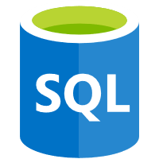

Real-time file processing
Scenario Example
Healthcare
Patient records are securely uploaded as PDF files. That data is then decomposed, processed using OCR detection, and added to a database for easy queries.
PDF file added to Blob Storage
A function decomposes PDF file…
…and sends it to Cognitive Services for OCR detection
Structured data from file sent to SQL DB

Slide 22


Real-time stream processing
App or device producing data
Scenario Example
ISV
Huge amounts of telemetry data is collected from a massive cloud app. That data is processed in near real-time and stored in a DB for use in an analytics dashboard.
Event Hubs ingests telemetry data
A function processes the data…
…and sends it to Cosmos DB
Data used for dashboard visualizations

Slide 23

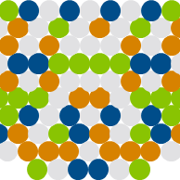
Automation of scheduled tasks
Scenario Example
Financial Services
A customer database is analyzed for duplicate entries every 15 minutes, to avoid multiple communications being sent out to same customers.
A function cleans a database every 15 minutes…
…deduplicating entries based on business logic

Slide 24




Extending SaaS applications
Scenario Example
Professional Services
A SaaS solution provides extensibility through webhooks, which can be implemented through Functions, to automate certain workflows.
Issue created in GitHub…
…which triggers a webhook call
…which is processed by a function…
…by posting the issue details to Slack

Slide 25


What makes Functions unique?
Feature variety
Flexible run options
A host of features, from bindings to code editors, gives you the tools needed to quickly create the best apps
Durable Functions
With so many plan options, you can choose the level of access that’s best for your company and customers
With this extension Azure Functions help you simplify complex, stateful orchestration problems
Intuitive experience
Consolidated tools
Easy-to-use, familiar tools like the Azure portal and Visual Studio help you get running on serverless fast
Thanks to so many built-in solutions, you can do more in Functions than AWS, which often requires external tools
Notes:
Speaker guidance: This slide emphasizes the content from the previous features slides. You can use it to reiterate certain value points or, if you’re short on time, use it as a replacement for the feature slides. If neither, delete.

Slide 26

Azure Functions is an open-source project Functions runtime and all extensions are fully open source
https://github.com/Azure/Azure-Functions
Notes:
Azure Functions spans in about 10 separate projects on GitHub
About 60 contributors from the community across hundreds of commits
All issues and sprints are triaged and tracked fully in the open, anyone can see exactly what code is running in the cloud and what is being worked on next
More info in - https://github.com/Azure/Azure-Functions

Slide 27








Full integration with Azure ecosystem Functions is the center piece of the Serverless platform
Development
Platform
IDE support
Event Grid
Functions
Logic Apps
Manage all events that can trigger code or logic
Execute your code based on events you specify
Design workflows and orchestrate processes
Integrated DevOps
Local development
Monitoring
Database
Storage
Analytics
Intelligence
Security
IoT
Visual debug history

Slide 28


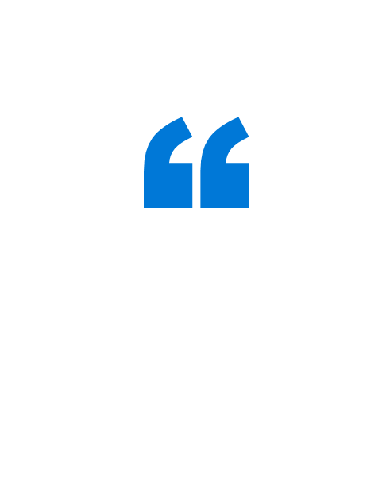
Direct.One is a Brazilian customer communications firm that sends out millions of billing statements and communications each month for customers. By using serverless computing, Direct.One generates five times more transactions for less than a quarter of its previous costs, and it can develop new features 40% faster – huge competitive advantages in a business where speed and volume are everything.
By integrating Azure Functions into our processes, we’ve been able to generate five times more transactions for less than a quarter of the cost of using virtual machines.
Fernando Wosniak Steler Founder and Chief Executive Officer Direct.One
Notes:
Case study source: https://customers.microsoft.com/en-us/story/direct-one-professional-services-azure

Slide 29


Relativity wanted to improve the customer experience of its RelativityOne cloud-based e-discovery platform. The company decided to create a monitoring solution based on a serverless architecture powered by Microsoft Azure Functions that proactively identifies and resolves performance issues. Now, some projects that used to require a few months, can be completed in a few days.
When we can develop a solution in a week using Azure Functions versus four months using traditional methods, that represents a drastic improvement in our ability to solve business-critical problems.
Hristo Papazov Senior Software Engineer Relativity
Notes:
Case study source: https://customers.microsoft.com/en-us/story/direct-one-professional-services-azure

Slide 30


FUJIFILM Software, the software arm of the multinational photography and imaging company, started using Functions to develop its file management solution, called IMAGE WORKS, in separate service units. This, along with implementing microservices with Functions, boosted the solution’s stability and helped FUJIFILM cut development time for new functions by 75%.
A long development and build period can lead to missed business opportunities. So Azure deserves high praise for helping us get to a fully validated release in six months.
Daichi Hayata Design Leader Advanced Solutions Group, IMAGE WORKS Team FUJIFILM Software
Notes:
Case study source: https://customers.microsoft.com/en-us/story/fujifilm-software-co-ltd

Slide 31


Quest, an IT consultancy, uses Functions as the foundation for Quest On Demand, the firm’s Azure-based, SaaS platform for managing Microsoft Azure Active Directory and Office 365 users and workloads. Functions gives Quest’s DevOps team the perfect solution for running small bits of code efficiently and bringing innovative product value to market faster. It has also reduced the firm’s overall costs.
Azure Functions enables a pay-for-what-you-use compute model at micro-penny rates. That saves significant CAPEX infrastructure investments, as well as OPEX costs, not to mention less procurement, commissioning time, and ongoing management. Plus, it’s more cost-effective for our customers to closely align their costs to usage, which they welcome.
Curtis Johnstone Distinguished Engineer and Microsoft MVP
Microsoft Platform Management Business Unit Quest
Notes:
Case study source: https://customers.microsoft.com/en-us/story/quest

Slide 32


Plexure, an IT developer for retailers, began using Functions to quickly deploy custom extensions by only running the small pieces of code required for that solution. It then used a combination of Functions and Azure Logic Apps to create an interface that customers could use to load their own code, and a microservice that deploys the code to the Azure resource group assigned to each customer.
We realized that we could use Azure Functions to let our customers create and edit their own extensions. Then they wouldn’t need to rely on our engineers or wait through any delivery process, and we could focus more time on innovating our platform.
Richard Stinear
Head of Engineering
Plexure
Notes:
Case study source: https://customers.microsoft.com/en-us/story/plexure-dev-azure

Slide 33


CarMax, the largest used car retailer in the United States, redesigned its website using Azure to deliver more-innovative services to the 16 million people who visit the site each month. Functions has been part of this transformation, giving the software development team an agile solution to test and launch new features in a fraction of the time and at a reduced cost.
We are no longer constrained in what we can execute. There was a time when implementing 360-degree photos or video would have been prohibitively difficult on our existing infrastructure. But with Azure, we have the ability to deliver anything the customer wants.
Brandon Linton
Solution Architect
Online Systems Platform Team
CarMax
Notes:
Case study source: https://customers.microsoft.com/en-us/story/carmax

Slide 34


ZEISS is a manufacturing company focusing on optics and optoelectronics. The manufacturer used Azure to create a digital integration architecture, the Enterprise Service Bus (ESB), that allows field devices to connect to backend systems. For stateless scenarios, the ESB leverages Functions to handle incoming messages, processing about a half-million SAP messages per day.
The scalability of Azure Functions in amazing. We can send out millions of records, and the platform adjusts automatically to the load.
Kai Walter
Lead Solution Architect
Carl Zeiss AG, ZEISS parent company
Notes:
Case study source: http://customers.microsoft.com/en-us/story/zeiss-manufacturing-azure

